Slide 1
V111414
Developer Bootcamp
Node.js and Apigee-127
Notes:
For customer presentations consider putting the customer’s name on the first slide.

Slide 2
Course Topics
Node.js:
Node.js Crash Course
Deploying and maintain a Node.js application in Apigee Edge
Volos: Caching, quota, OAuth and DB connectors
Troubleshooting, testing, debugging, and help
Apigee-127
Building API Specs / Docs
Creating Controllers
API Management
Deploying the APIs

Slide 3
Node.js Crash Course

Slide 4
Introduction to server-side JavaScript, Node.js, and NPM
Node.js – software platform for scalable server-side and networking applications.
Different than javascript
Why use Node.js?
Javascript running on the server
Asynchronous, event-drive
HTTP is a first-class citizen of the Node world
Exploding in popularity
Notes:
Node.js is a software platform for scalable server-side and networking applications. Node.js applications are written in JavaScript. All of the popular server operating systems are supported, including Windows and Linux.[3]
Node.js is a runtime environment combined with libraries for common web application requirements. Internally, it uses the Google V8 JavaScript engine to execute code, and a large percentage of the basic modules are written in JavaScript. (Although in Apigee, it runs inside Trireme, a Rhino-based engine that runs inside the JVM).
Node.js contains a built-in asynchronous I/O library for file, socket and HTTP communication. The HTTP and socket support allows Node.js to act as a web server without additional web server software such as Apache.
Why use Node.js
- Node.js is great way to learn the Apigee product - even if you're not experienced with the Apigee environment, Node is widely used and requires minimal JavaScript experience to learn.
- Node apps (proxies) can be run completely offline - great for running unit tests and for developing/debugging. Volos also allows you to develop offline and deploy to the Apigee cloud taking full advantage of Apigee benefits.
- Node apps (proxies) can be and deployed independently of the Apigee platform (platform agnostic) - develop once, use anywhere.
- Node is a very popular open source project (great for support and extensibility)
- Developers who build applications in Node don't need to re-learn the Apigee product in order to use the platform. Also doesn't require a developer to know Apigee in order to use the products.

Slide 5
Node.js and Apigee Edge
Node extends the programmability of Edge via NPM
Node allows you to connect to backend databases directly
Proxies can be built using a few lines of code
Node is widely used and requires minimal javascript experience to learn
Node apps (proxies) can be run completely offline and are platform agnostic - great for running unit tests and for developing/debugging and developing once and using anywhere
Volos also allows you to develop offline and deploy to the Apigee cloud taking full advantage of Apigee benefits.
Asynchronous HTTP requests can be orchestrated and optimized much simpler using Node.js.
If you are heavily manipulating and mashing up payloads, Node keeps this process clean and human-readable.
Allows you to run a full test suite against your app in your own environment or offline.
Notes:
What does it bring to the Apigee ecosystem?
- Node extends the programmability Edge by way of Node's extensive plugin/module library (NPM).
- Node allows you to connect to back-end databases directly, without first needing to build a connector or API.
- Building proxies can be done in just a few lines of code and promotes rapid development.
- Node.js is great way to learn the Apigee product - even if you're not experienced with the Apigee environment, Node is widely used and requires minimal JavaScript experience to learn.
- Node apps (proxies) can be run completely offline - great for running unit tests and for developing/debugging. Volos also allows you to develop offline and deploy to the Apigee cloud taking full advantage of Apigee benefits.
- Node apps (proxies) can be and deployed independently of the Apigee platform (platform agnostic) - develop once, use anywhere.
- Asynchronous HTTP requests can be orchestrated and optimized much simpler using Node.js.
- Node is a very popular open source project (great for support and extensibility)
- Developers who build applications in Node don't need to re-learn the Apigee product in order to use the platform. Also doesn't require a developer to know Apigee in order to use the products.
- If you are heavily manipulating and mashing up payloads, Node keeps this process clean and human-readable.
- Allows you to run a full test suite against your app in your own environment or offline.

Slide 6
When to use Node.js in Apigee Edge
When should I use Node.js in Apigee Edge?
When you need intelligent, asynchronous processing logic
When you’ve already built your API in Node and don’t want to rebuild it from scratch
What does Node.js look like in Apigee Edge?
Handling and manipulating JSON data with JavaScript
http://jsfiddle.net/remus/z4Y68/
Notes:
JSFiddle – move apigee ed account

Slide 7
Node Installation

Slide 8
Asynchronous Programming
JavaScript objects and parsing response JSON
“What” and “why” of asynchronous programming with Node.js
Understanding blocking code
Callbacks, promises and basis of asynchronous design

Slide 9
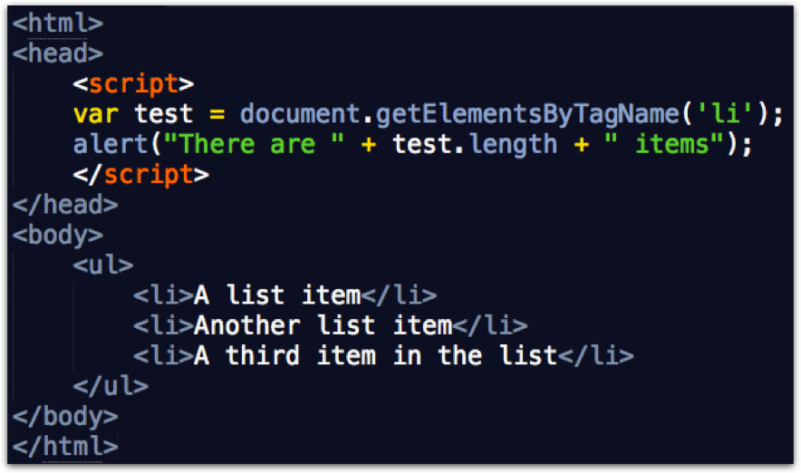
Blocking
http://jsfiddle.net/grewis/p5nf8hdf/
Notes:
http://jsfiddle.net/grewis/p5nf8hdf/
JavaScript objects and parsing response JSON
“What” and “why” of asynchronous programming with Node.js
Understanding blocking code: instructor demonstration
Callbacks, promises and basis of asynchronous design
Discussion

Slide 10
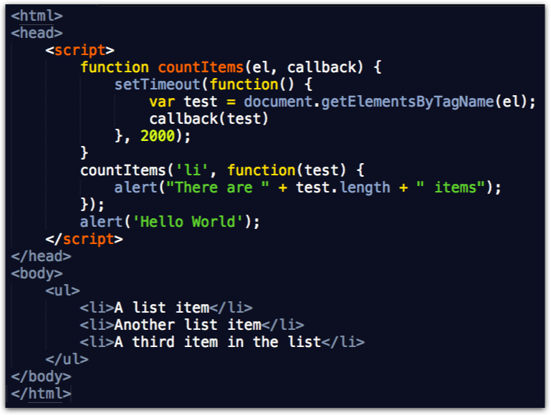
Non-blocking
http://jsfiddle.net/grewis/3mm2qtac/
Notes:
http://jsfiddle.net/grewis/3mm2qtac/
Discuss how the asynchronous stuff *can* be done with Javascript callouts (a single one, designed to be async)
Javascript callouts in series are NOT async
Node leverages existing open source projects that are used the world over – rock solid and great at doing this

Slide 11
The World’s Simplest Web Server
j.mp/api-v1-node-simple
Notes:
j.mp/api-v1-node-simple

Slide 12
The World of NPM
Notes:
NPM: Node Package Manager
https://www.npmjs.org/
Have them browse packages in their own time

Slide 13
NPM Packages and other resources
Apigee developed NPM packages:
apigee / apigee-access
volos (cache, quota, oauth)
Usergrid
Popular Editors/IDE used by Apigee developers:
http://www.sublimetext.com/3
https://www.jetbrains.com/webstorm/
If using Sublime, you can configure a build system with either regular Node.js or nodemon. Nodemon will automatically restart your node app upon code saves. http://nodemon.io/
Notes:
- Apigee has created some great packages for Node (briefly discuss, more on these later hands on)

Slide 14
Modules Must be Installed

Slide 15
Installing Modules with NPM
Individual modules must be installed using the NPM command line
Once installed (node_modules folder), they are added to the app using require(‘module name’)
Notes:
- Discuss the different npm commands and mention that –g can break things. Best practice is to install for each instance.
Why do we install node locally? Benefits of installing locally? Unit tests, regression tests, QA.
Also robust integration and platform independence.

Slide 16
Installing Multiple Modules
When a Node.js app launches, it looks for a file, package.json, in the same folder and the main JS file to determine if all of its ‘pieces’ are present
Using npm install will install all of the listed dependencies at one time.

Slide 17
Express Routes
Express uses routes and provides simple routing out of the box: app.METHOD(path, [callback...], callback).
app.get(‘/hello’, callback) … will catch a GET request to path /hello
The callback function (req,res){} allows you to work with the request (req) and response (res) objects.
app.use(“/”, [function...], function) mounts middleware functions to be executed at the path. This case will have the express.static() function execute for every request in the app.
j.mp/api-v1-node-simple-02
Notes:
Students should have completed pre-course work – installing Postman (or alternative), Node.js, and have this basic version running
Test by going to http://localhost:XXXX (port number)
Does this correspond to slide 11?

Slide 18
Use Multiple Routes to Expose API Resources
Handling multiple (conditional) routes and multiple HTTP request methods
Route syntax / , / path , / path/:parameter
Use multiple route listeners for specific HTTP requests for resources
‘express-params’ module allows you to use app.param() to define a request parameter and perform validation
Accessing and sending HTTP headers and request parameters
Routes and headers
req.params.{routeParameter} and req.headers.{header}
var express = require(‘express’);
var params = require(’express-params');
var app = express;
params.extend(app);
app.get('/', function(req, res){
res.send(’Hello, world. We meet again.');
});
app.param('id', /^\d+$/);
app.get('/user/:id', function(req, res){
res.send('user ' + req.params.id);
});
app.param('range', /^(\w+)\.\.(\w+)?$/);
app.get('/range/:range', function(req, res){
var range = req.params.range;
res.send('from ' + range[1] + ' to ' + range[2]);
});
Notes:
You can add a question mark to the end of a route parameter to make it optional (/path/:object?)

Slide 19
Executing 3rd Party HTTP/S Requests from Node.js
request module allows you to execute HTTP requests from your node.js app
common module used for 3rd party HTTP requests
Can perform GET, POST, PUT and DELETE requests from your Node.js server
pipe() function allows you to pipe the response of the the 3rd party request to the response being sent back to the client from your node.js app
app.all('/:uuid', function(req, res){
if (req.method === 'PUT') {
req.pipe(request.put(basepath + req.params.uuid));
} else if (req.method === 'GET' || req.method === 'HEAD') {
request.get(basepath + req.params.uuid).pipe(res)
}
});
Notes:
Instructor notes: Demo the Apigee HR API
Use the image proxy example to demo pipe: http://apigeecertification-prod.apigee.net/images/images/92e0304a-0586-11e4-af32-dba2aeab5bdc/image.jpg
(Instructor link: https://enterprise.apigee.com/platform/#/apigeecertification/apis/images/1?section=develop)

Slide 20
Using the async Module to Help with Callbacks
async – another node.js module to help work with callbacks in node.js
Eek! How do we know when our multitude of requests are finished?
Provides better experience for asynchronous API mash-ups, multi-threaded requests, and robust error handling
async’s provides: series , parallel , and waterfall .
async.waterfall([
function(callback){
callback(null, 'one', 'two');
},
function(arg1, arg2, callback){
// arg1 now equals 'one' and arg2 now equals 'two'
callback(null, 'three');
},
function(arg1, callback){
// arg1 now equals 'three'
callback(null, 'done');
}
], function (err, result) {
// result now equals 'done'
});
Notes:
Show a demonstration of series, parallel and waterfall
Each takes an array or set of objects and performs a function against them asynchronously (great for data manipulation!)
Discuss parallelLimit

Slide 21
Data Manipulation and Mashups with Node.js
Improve the API response by:
Parsing JSON into a JavaScript object
Manipulating (mashing-up) arrays and dictionaries/key:value maps
Stringifying and writing the output ( res.json or JSON.stringify() )
Setting the proper HTTP status codes
200 OK, 401 Unauthorized, 404 Not Found, etc.
Mashing up multiple API calls with async module
Require async in your Express app
Create a parallel request with named callbacks
Mash up products, ratings, and reviews
Notes:
Example to use: server-slide20.js
In the end, it isn’t exactly a pretty response. Do we need to clean it up even more? What can we do to make it better? (discuss)
Let’s do that later though.

Slide 22
Node.js Application Architecture
Models, (views?), and controllers
Route Performance impact to module separation (only at run-time!)
Node’s require module for separation of reusable functions
Creating and including modules with module.exports
Create a new file, misc.js and add the following:
var x = 5;
var addX = function(value) {
return value + x;
};
module.exports.x = x;
module.exports.addX = addX;
Include misc.js in the main app.js to leverage the exported variables/functions:
var misc = require('./misc.js');
console.log("Adding %d to 10 gives us %d", misc.x, misc.addX(10));

Slide 23
Deploying and maintaining a Node.js application in Apigee Edge

Slide 24
Supported Modules and Pre-installed Packages in Edge
Apigee Edge does not support all modules that can be used in node.js apps. A detailed listing can be found on this documentation page:
http://apigee.com/docs/api-services/content/understanding-edge-support-nodejs-modules
Trireme and the Apigee Node.js environment
Installing additional NPM packages and the apigeetool
Notes:
“the back story” look up the Trireme github project and discuss emulation, running inside the JVM, and performance.
This "port" argument is required in Node.js, but Apigee Edge ignores this parameter. Instead, the API proxy in which the Node.js script runs specifies the "virtual host" that it listens on, and the Node.js application uses those same virtual hosts, just like any other Apigee Edge proxy.
Coding the port number to be retrieved from an environment variable conditionally, as shown in the example above, is considered a best practice by Apigee.
Why the cluster module is disabled

Slide 25
Configuring an API Proxy to Run a Node Application
When deploying a node application to Apigee edge, the node app is configured inside of the existing API proxy structure. There are slight modifications to the
-node-demo-proxy/
-apiproxy/
-policies/
-proxies/
-targets/
-resources/
-node/
-app.js
-node_modules.zip
The node_modules directory must be zipped.
<ProxyEndpoint name="default">
<HTTPProxyConnection>
<BasePath>/employees</BasePath>
<VirtualHost>default</VirtualHost>
</HTTPProxyConnection>
<RouteRule name="default">
<TargetEndpoint>default</TargetEndpoint>
</RouteRule>
<PreFlow name="PreFlow"
<Request/>
<Response/>
</PreFlow>
</ProxyEndpoint>
<TargetEndpoint name="default">
<ScriptTarget>
<ResourceURL>node://server.js
</ResourceURL>
</ScriptTarget>
<EnvironmentVariables>
<EnvironmentVariable name=”myVariable”>VALUE
</EnvironmentVariable>
</EnvironmentVariables>
<Arguments>
<Argument>ARG</Argument>
</Arguments>
</TargetEndpoint>
Specify main node app as a <ScriptTarget><ResourceURL>
<EnvironmentVariables> can be specified in TargetEndpoint and then referenced in the node.js code as var myVariable = process.env.myVariable;
Notes:
Why would you do this?
Legacy systems connect
Migration path
Demonstrations
Supporting a developer-friendly environment (deploying a custom upload Node) while offering API key management, caching, etc. (developer portal)

Slide 26
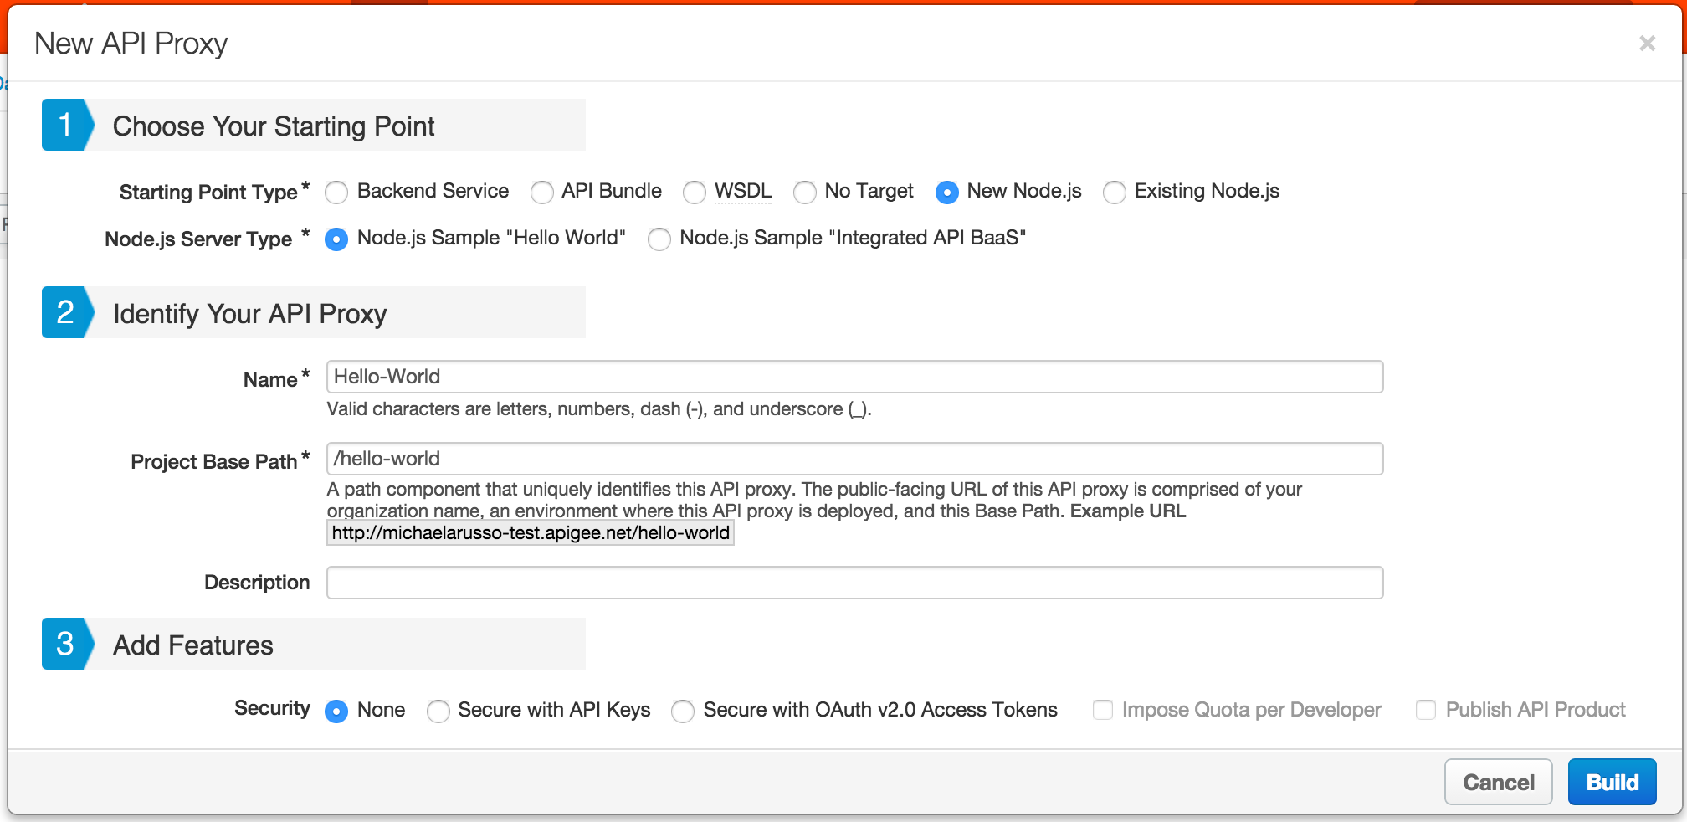
UI Wizard for creating Node.js API Proxy Skeletons
Create a new Node.js proxy in Apigee Edge UI
Notes:
Class should already have an Edge account created. If not, please create one and log in.

Slide 27
Deploying and Maintaining a Node app in Apigee Edge
Limitations of creating a Node.js proxy through the Edge UI
If a bundle is uploaded, node_modules are not auto compressed
Handy for creating simple or on-the-fly Node scripts
Apigee api-platform-tools
You should have it installed already: https://github.com/apigee/api-platform-tools
For Windows, install python for Windows (2.7): https://www.python.org/downloads/windows/

Slide 28
Use apigeetool to deploy node apps from command line
Deploying a Node.js proxy from the command-line tool
Example directory structure for above command:
Testing our success
You should be able to access your Node.js proxy from here: http(s)://{org}-{env}.apigee.net/{basepath}/
apigeetool deploynodeapp -o michaelarusso -e test -n node-demo -u mrusso@apigee.com -d . -m app.js -b /node-demo-app
-o {apigee organization}
-e {apigee environment}
-n {apigee API proxy name}
-u {apigee edge username}
-d {directory where the node app.js file exists}
-m {node app file name used for TargetEndoint ResourceURL (app.js in this example)}
-b {basepath to use for the imported proxy}
workspace/
-node-demo-app/
-app.js
-node_modules/
-express-params/
Notes:
This one is less instructor hands on – let’s see if the class can do it!
Zipping nodemodules is an issue (breaks the UI), will be changing in the next generation of Node.js with Apigee 127 (will be deployed as part of Edge automatically)

Slide 29
Volos: Caching
and Quota Management

Slide 30
What is Volos
volos-* and the apigee-access modules
Volos is platform agnostic
https://github.com/apigee-127/volos
With Apigee, leverage
Authentication and handling OAuth tokens
Accessing policy flow variables
Access Apigee environment details
Database connectors (MySQL, Postgres, Mongo)
Cache and quota management (Apigee, memory, Redis)
Securely storing sensitive data with avault
Notes:
Apigee 127 and Volos are platform agnostic. You can use them independently of the Apigee platform, or deploy and leverage Apigee cache, quota, Oauth, etc.
Let’s talk about the different modules available under Volos – volos-cache-memory, volos-cache-apigee (these can be quickly switched and interchanged, with a unified API.
Avault: https://www.npmjs.org/package/avault

Slide 31
Executing HTTPS requests from Node.js
Incoming one-way SSL requests:
Use the tls module to create secure backend connections
Outgoing one-way SSL requests:
Add client-side keys and certificates (.pem files) to the resources/node directory and load them in your script.
More info
http://apigee.com/docs/api-services/content/understanding-edge-support-nodejs-modules
Notes:
Handling outgoing requests
You can make outgoing requests with the tls module the same way you would normally in Node.js. Basically, you need to add client-side keys and certificates (.pem files) to the resources/node directory and load them inside your script. For information on using the tls module and its methods, see the Node.js tls module documentation.
If you use custom TLS/SSL certificates or trust stores, the Apigee Edge support for outbound requests works differently. Contact Apigee Support if you have questions.
More info: http://apigee.com/docs/api-services/content/understanding-edge-support-nodejs-modules

Slide 32
Demo of Caching and Quota Management with Volos
var express = require('express');
var app = express();
var quota = require('volos-quota-memory').create({
timeUnit: 'minute',
interval: 1,
allow: 10
});
var cache = require('volos-cache-memory').create('demo', {
ttl: 2000
});
var counter = 0;
app.get("/cache", cache.connectMiddleware().cache(), function(req, res) {
console.log('Cache counter: %s', counter);
res.json({
count: counter++
});
});
app.get("/quota", quota.connectMiddleware().apply({
identifier: 'demo',
weight: 1
}), function(req, res) {
var currentQuotaCount = quota.connectMiddleware().quota.quota.buckets.demo.count;
console.log('Quota counter: %s', currentQuotaCount);
console.log('Hit counter: %s', counter);
res.json({
hitCounter: counter++,
quota: currentQuotaCount
});
});
app.listen('8000', function(req, res) {
console.log("Server initialized on port 8000");
});

Slide 33
Troubleshooting, testing, debugging, and help

Slide 34
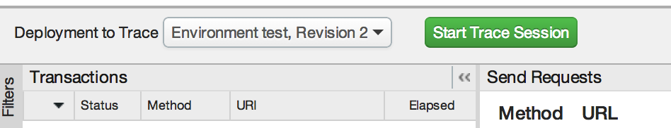
Troubleshooting
Troubleshooting Node.js using the Apigee Trace tool
Inspecting requests, responses, and HTTP status codes
console.log()
Notes:
Needs to show how to access Node.js logs and trace (screenshot)

Slide 35
Troubleshooting and debugging
Handling dependencies and dependency conflicts
Express 3.7 and Connect 3.0 (deprecation notices and removal of middleware)
Conflicting module versions in Apigee Edge
Handling response errors and node script failures/crashes
Error handling in JavaScript (try/catch)
Syntax errors in Node.js

Slide 36
Troubleshooting, debugging, and where to get help
The node-inspector tool
Browser-based Node.js debugger
Navigate in your source files
Set breakpoints (and specify trigger conditions)
Step over, step in, step out, resume (continue)
Inspect scopes, variables, object properties
Webstom IDE
A feature-rich IDE for Javascript/Node.js

Slide 37
Getting help
Getting help
StackOverflow has an incredible wealth of Node.js knowledge
How to ask: http://stackoverflow.com/help/how-to-ask
Apigee Community
http://community.apigee.com/
Apigee doc
http://apigee.com/docs/api-services/content/getting-started-nodejs-apigee-edge
Notes:
Show SO examples! Ask audience to ask a question

Slide 38
Apigee 127

Slide 39
Installing Apigee 127
Apigee 127 is installed using the command line – note that you may have to use sudo on a Mac
npm install -g apigee-127
Using the -g option installs a127 global (not local to the current directory) and is recommended.

Slide 40
Creating an Apigee 127 Project
Using the command line, navigate to the location where you want to store the project. This will create a folder where your source code will exist.

Slide 41
Apigee 127 Project Structure

Slide 42
Try it out
Navigate inside of the root project folder, then execute the command a127 project start
Once the project is started, you should now be able to access the API at http://localhost:10010/hello?name=Scott
Notes:
http://localhost:10010/hello?name=YOUR-NAME-HERE

Slide 43
Apigee-127
Building API Specs/Docs

Slide 44
The Swagger Editor
The goal of Swagger is to define a standard, language-agnostic interface to REST APIs which allows both humans and computers to discover and understand the capabilities of the service without access to source code, documentation, or through network traffic inspection.
A127 integrates Swagger to make it easier for developers to define RESTful APIs using Node.js.

Slide 45
Launching the Swagger Editor
Run the command a127 project edit to launch the swagger editor.

Slide 46
Apigee-127
Creating Controllers

Slide 47
How do Controllers Work?
All controllers are stored in the api/controllers folder
The name of the controller (.js file) must match the x-swagger-router-controller: value in the swagger doc

Slide 48
How do controllers work?
Each controller exports an array of name/value pairings where the name corresponds to the operationId: in the swagger document and the value is the function within the controller

Slide 49
Create a Config
So that we don’t have to repeatedly write a long URL, create a file named ‘config.js’ in the root level of your app folder
Add the following – making any changes to your own port and Usergrid information

Slide 50
Apigee-127
API Management / Workshop

Slide 51
Using Volos
Volos provides a way to leverage common features such as OAuth 2.0, Caching and Quota management into your APIs
Oauth 2.0 supports bearer tokens and all standard grant types
Uses Redis (in-memory storage) or the Apigee platform for data storage
Quota counts API calls and rejects them when the defined limit is exceeded during the specified time period
Caching can be in memory, using Redis or the Apigee platform

Slide 52
Implementing a Cache
In the swagger spec, add the following to the x-volos-resources key to apply a 10 second cache
Apply the cache to the /restaurants API by adding the following code

Slide 53
Implementing a Cache
Using the Chrome Developer Tools (Cmd+Opt+I on Mac, F12 on Windows), call an API using volos caching and view the response headers. You’ll see the appropriate cache directives.

Slide 54
Adding a Quota
Add the following to x-volos-resources to set a limit of 2 calls per hour*
Apply the quota to the POST operation of the restaurants API
* this is a completely silly example, buy at least you can see it happen easily

Slide 55
Adding a Quota
Refresh your API a few times and watch as the limit is applied using the Chrome Developer Tools

Slide 56
A Word of Caution
Example may not allow you to request more than twice because it is allowing the request as long as the cache is still valid
The order of the policies determines their order of execution – in other words, if you reverse the cache and quota order in the Swagger document, quota will be enforced first and you will only be able to make two requests each hour
Go ahead . . .give it a try!

Slide 57
A127 Deployment Accounts
When using Apigee Edge for Oauth, you need to provision an Apigee-127 deployment account to generate a proxy key and URI that will be used by the Swagger definition.
Create an A-127 deployment account
A-127 account creation workshop
Use your Apigee Edge account information for the following options:
Provider
Organization
Username
Password
Environment
Use the defaults (hit return) for all the other values

Slide 58
Create a Deployment Account

Slide 59
Adding OAuth 2 Support
To use Apigee Edge for OAuth we will first need to generate a client id and client secret
Open the Apigee Edge Dashboard
http://accounts.apigee.com/account/dashboard
Launch the API Management Portal
Go to Publish > Developer Apps, and create an app to use to simulate an API client.

Slide 60
Exposing an Oauth2 API Endpoint with a127
Add the following to x-volos-resources to specify the use of OAuth, and add the requirement to your API
Example API Swagger: j.mp/api-v1-node-swagger-final
Notes:
Example swagger - j.mp/api-v1-node-swagger-final

Slide 61
Obtaining an Access Token
Using Postman or other REST client, send a POST to the /accesstoken API
Set the Header to Content-Type: application/json
Pass the client credentials as JSON as shown in example below

Slide 62
Using the Token for Accessing API Resources
The access token must be passed in the request header as the value of the Authorization header
The token is passed together with the Bearer keyword

Slide 63
Token Expiry
When a token expires (like it might have happened to you if you were too slow), a new token must be issued
Change the tokenLifetime (in ms) in the Swagger document to something more reasonable
1 hour = 3600000
1 day = 86400000
1 week = 604800000
Repeat the steps to request a token – then change the token in your API requests

Slide 64
Apigee-127
Deployment Config / Deploying to Edge

Slide 65
Manage Config Data by Exporting a Module
Create a ‘config.js’ to and export an object that contains the urls or other config data.

Slide 66
Deploying
To deploy to the Apigee Edge Gateway

